Slide 1
WWII in the Pacific
Year 10 HASS
History – World War 2
War in the Pacific

Slide 2
Do Now
What was a significant battle fought in WWII (in Europe)?
Why was it important?

Slide 3
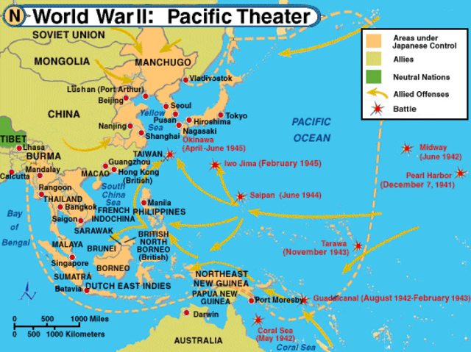
Lesson Intention
To understand the cause and course of WWII in the Pacific

Slide 4
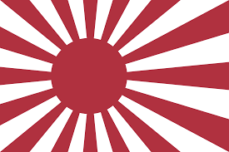
Japan post WWI
Compared to many Asia-Pacific countries, Japan was a powerful, independent and nationalistic country with a strong army.
Limited access to natural resources (oil, coal, rubber, iron ore) for steel production. It relied on countries such as China and the USA for these.
Supported the allies in WWI, however was disappointed by the terms of the T.O.V.

Slide 5
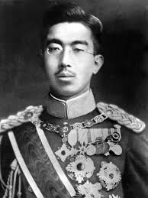
Japanese expansionism
Similar to Germany, the Great Depression of the 1930’s caused mass unemployment and major social issues in Japan. Many people blamed their struggles on their government.
This led to a military take over of the government. One army leader, Hirohito, became the new emperor of Japan.
He sought to solve the country’s economic problems through foreign expansion. He wanted to conquer China in order to obtain raw materials and markets for their goods.

Slide 6
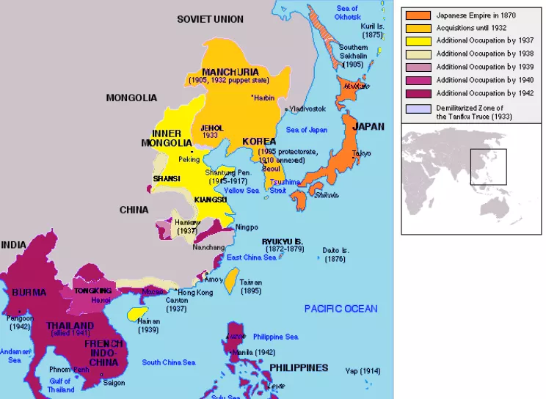
The Greater East Asian Co-prosperity Sphere
Throughout the interwar period, Japanese politics was dominated by extreme nationalist and militarist movements.
The military soon had more power than its government.
One of the main ideas wat to create a ‘Greater East Asian Co-prosperity Sphere’. It was the idea that East Asia could exist free of Western Influence.
Proposed that Japan act as the leader of a bloc of Asian and Pacific nations working together. (It was mostly designed to give Japan greater influence and access to neighbouring countries’ resources).

Slide 7
Turn and Talk
Why did Japan want to conquer China after the Great Depression?

Slide 8
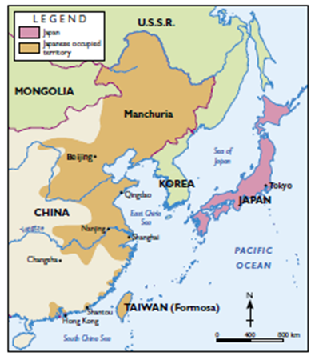
Japan invades China
1931, Japan invades Manchuria – the military did this against strict instructions from the government not to.
1937, Japan invades China.
The Japanese committed many human rights violations against the Chinese.
China protested to the League of Nations, but when it tried to sanction Japan, it withdrew from the League. Western powers were more concerned with threats to peace in Europe so took no effective action.
Watch the following video and be prepared to answer the question ‘What happened to the Chinese during the invasion of Nanjing?’
https://www.youtube.com/watch?v=gPMCSN-KEbU

Slide 9
Source Analysis
The following is the survivor account of Xia Shu-qin, a Chinese resident of Nanking that was 7 years old at the time of the Japanese invasion in 1937. Xia Shu-qin told this story to a Chinese interviewer in June 2005.
Based on Xia Shu-qin’s account explain how the Japanese violated the human rights of the people in China.
“It was about ten in the morning when a dozen Japanese soldiers with rifles and fixed bayonets (knives at the end of their guns) rushed into the house. They shot my father and grabbed my baby sister, who was being breast-fed by my mother. They stabbed the baby to death ... Then the Japanese killed my grandparents and … stabbed me and my 3-year old sister with bayonets. I saw both of my older sisters lying in pools of blood, dead."

Slide 10
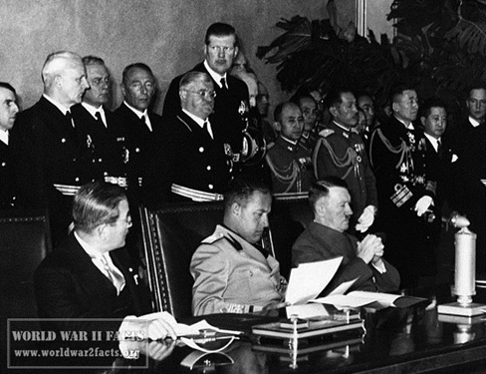
Connections to Europe
In 1939, Japan signed a non-aggression pact with the Soviet Union.
1940, Japan signed the Tripartite Pact with Germany and Italy. They are known as the Axis powers.
The Pact provided for mutual assistance should any of the 3 countries suffer attack by any nation not already involved in the war.
It recognised the two spheres of influence (Italy and Germany leaders of Europe, whilst Japan was leader of Greater East Asia).

Slide 11
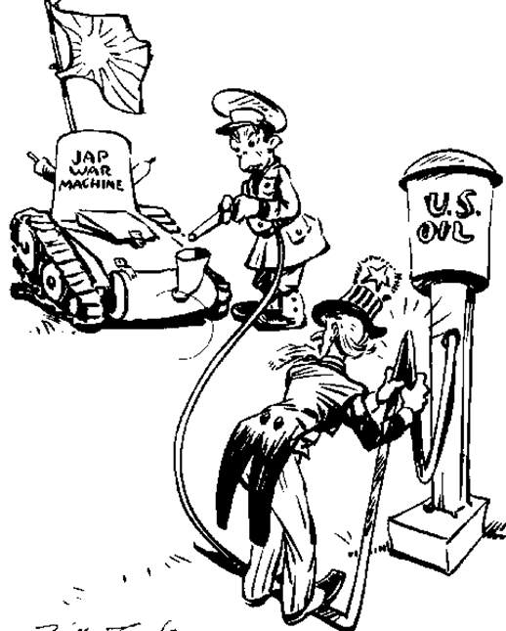
Appeasement
Although European colonial powers and the US were concerned about Japanese expansionism, they followed the policy of appeasement.
Germany seemed to be the greater threat.
It wasn’t until Japan’s occupation of Indochina that the Western nations began to act.
How did they react?
Restricted exports of materials including iron and steel
Froze Japanese assets
Restricted exports of oil (an essential import for Japan)
Japan tried to negotiate with the US/Allies, however they could not come to an agreement.
Indochina: modern day Vietnam, Laos and Cambodia

Slide 12
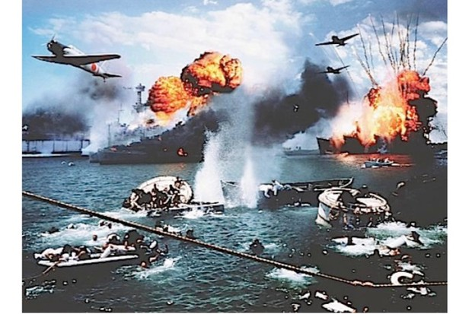
WWII in the Pacific Begins.
Japan was angered by this deliberate attempt to weaken their nation and attacked the U.S. at their naval base at Pearl Harbor. In the end, however, this attack only led to the U.S. entering the war and the ultimate demise of the axis powers in WWII.
Pearl Harbor Attack
Naval base at Pearl Harbor, Hawaii
7th December, 1941
Hoped to destroy America’s Pacific fleet as a preventative strike to stop American influence in the Pacific.

Slide 13
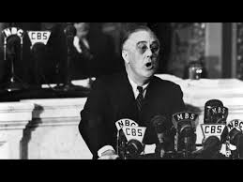
Source Analysis
Franklin D. Roosevelt's “Pearl Harbor” Speech (1941)
“Yesterday, December 7, 1941—a date which will live in infamy—the United States of America was suddenly and deliberately attacked by naval and air forces of the Empire of Japan… It will be recorded that the distance of Hawaii from Japan makes it obvious that the attack was deliberately planned many days or even weeks ago. During the intervening time the Japanese Government has deliberately sought to deceive the United States by false statements and expressions of hope for continued peace… I ask that the Congress declare that since the unprovoked and dastardly attack by Japan on Sunday, December 7, 1941, a state of war has existed between the United States and the Japanese Empire.”
Why does U.S. President Franklin D. Roosevelt ask congress to declare war on Japan?

Slide 14
Pearl Harbor
Write down three observations about what happened during the attack on Pearl Harbor as you watch the video
https://www.youtube.com/watch?v=ZWv-BrnSII4
1)
2)
3)

Slide 15
Declaration of War on Japan
While the attack on Pearl Harbor seemed to be successful, the damage was less than originally thought.
Rather than preventing American intervention, the attack caused the USA, Australia and the Netherlands to declare war on Japan.
Germany (Japan’s ally) declared war on the USA
Therefore, the USA was brought into the European war.

Slide 16
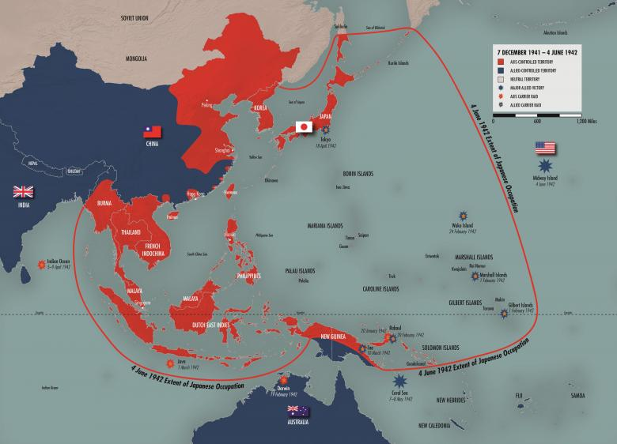
Extent of the Asia-Pacific region controlled by Japan by 1942

Slide 17
Turning points
Counter-offensives against the Axis powers and Japan began to inflict serious defeats in Europe and the Pacific.
Battle of Midway – June 1942 – Japan lost its aircraft carriers
Australian troops defeated the Japanese in Papua New Guinea between July 1942 and January 1943.

Slide 18
The end of the war
Atomic Bombs – were nuclear weapons required to end the war?
https://www.youtube.com/watch?v=gltrQGcLcAU
WWII Oversimplified 2
-4.56 onwards to 6.23
-10.52 onwards
https://www.youtube.com/watch?v=fo2Rb9h788s

